Slide 1


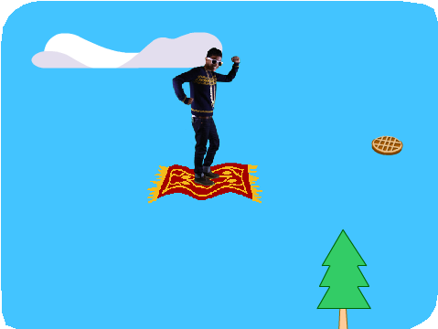

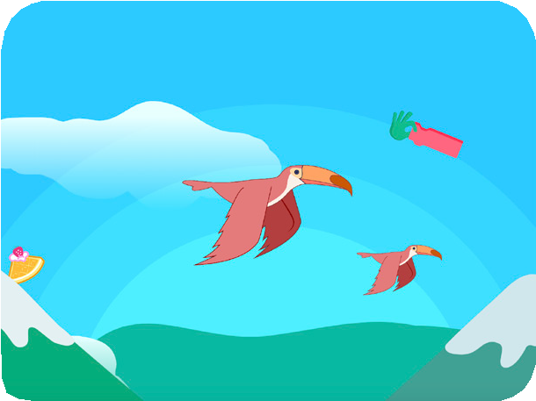
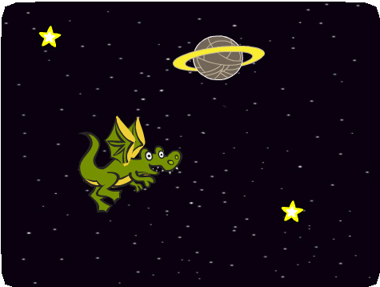

Make it Fly Cards
Make It Fly Cards
Choose any character and make it fly!
yyyymmdd
scratch.mit.edu
Set of 7 cards

Slide 2

Make it Fly Cards
Use these cards in this order:
Choose a Character
Start Flying
Switch Looks
Make it Interactive
Floating Clouds
Flying Hearts
Collect Points
scratch.mit.edu
Set of 7 cards

Slide 3




Choose a Character
Choose a character to fly.
yyyymmdd
Make It Fly
1

Slide 4


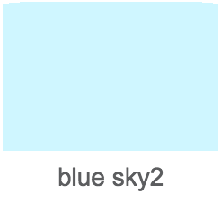

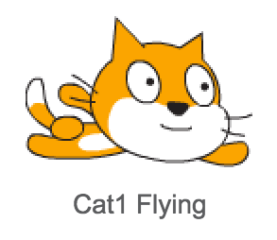
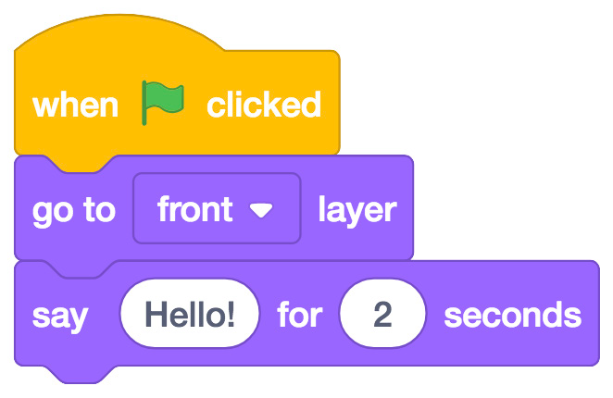
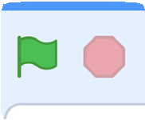
Choose a Character
scratch.mit.edu
GET READY
Choose a backdrop, such as “blue sky2”.
Choose a sprite from the Flying theme.
ADD THIS CODE
Type what you want your sprite to say.
TRY IT
Click the green flag to start

Slide 5
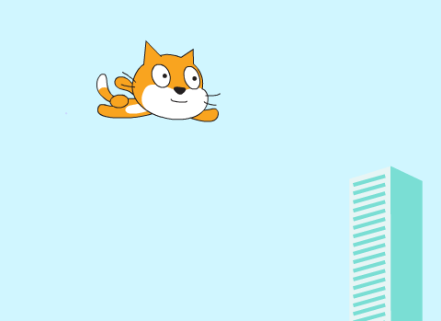

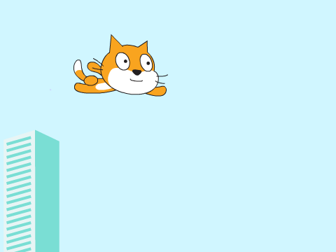
Start Flying
Move the scenery so your character looks like it’s flying.
yyyymmdd
Make It Fly
2

Slide 6



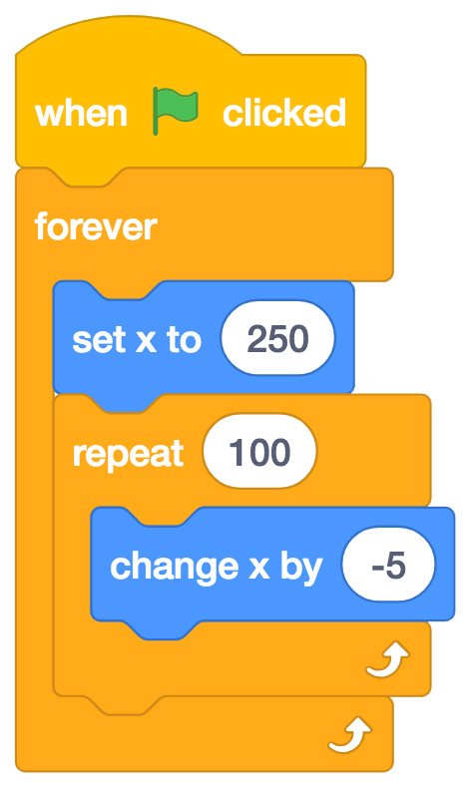
Start Flying
scratch.mit.edu
GET READY
Choose a sprite to fly by, such as Buildings
ADD THIS CODE
Start from the right end of the stage.
Type a negative number to move left.
TIP
x is the position on the Stage from left to right.
y = 180
x = -240
x = 240
y = -180

Slide 7
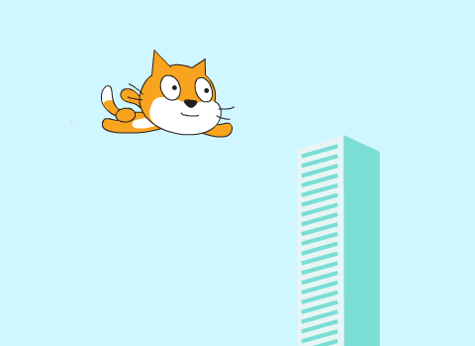
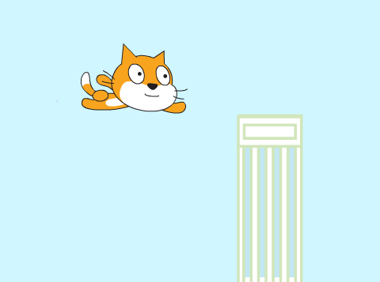

Switch Looks
Add variety to your scenery.
yyyymmdd
Make It Fly
3

Slide 8
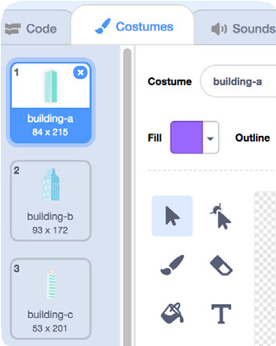
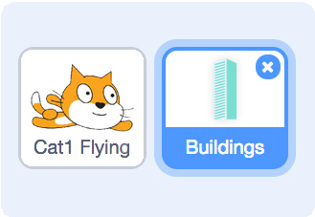

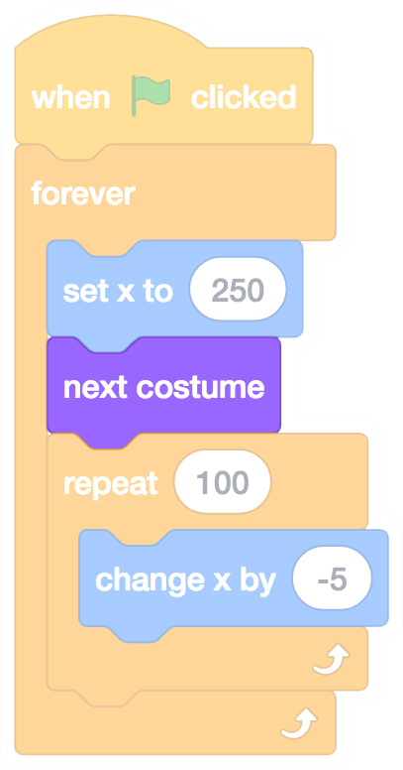

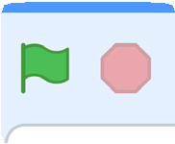
Switch Looks
scratch.mit.edu
GET READY
Click to select the Buildings sprite.
Then, click the Costumes tab to see the different building costumes.
ADD THIS CODE
Click the tab.
Add this block to switch costumes.
TRY IT
Click the green flag to start

Slide 9
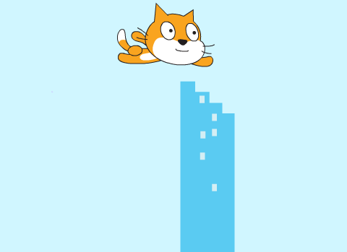
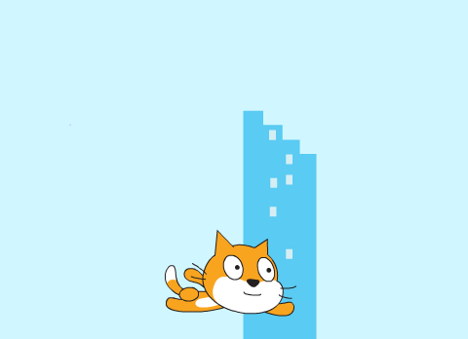
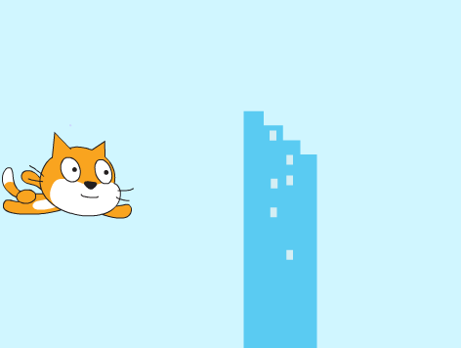
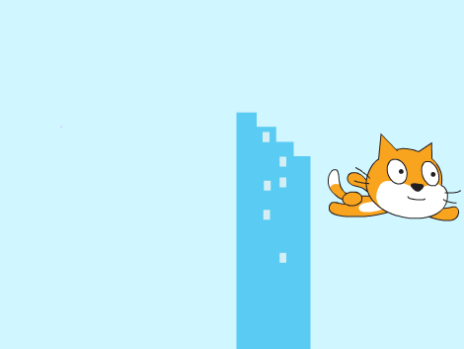
Make It Interactive
Make your character move when you press a key.
yyyymmdd
Make It Fly
4

Slide 10
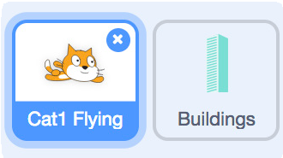
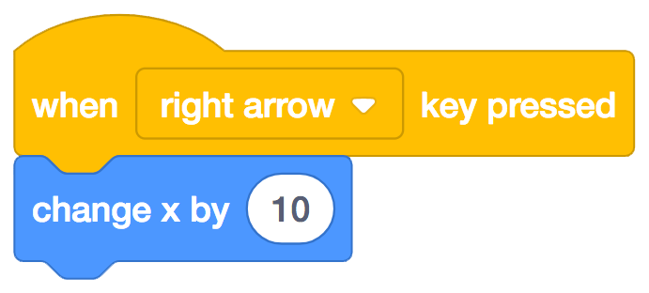
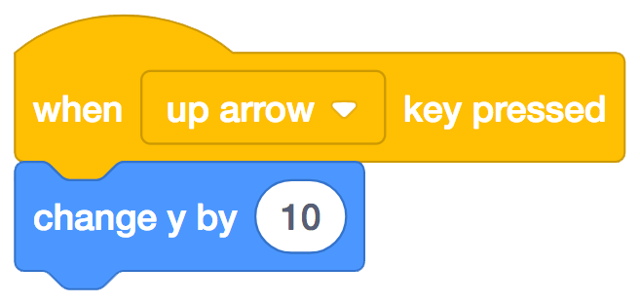
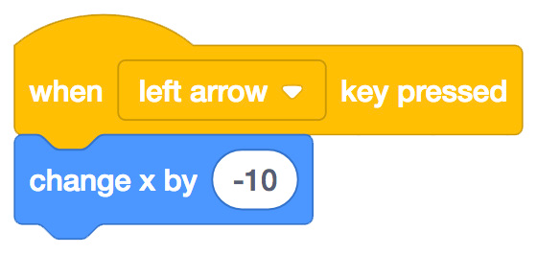
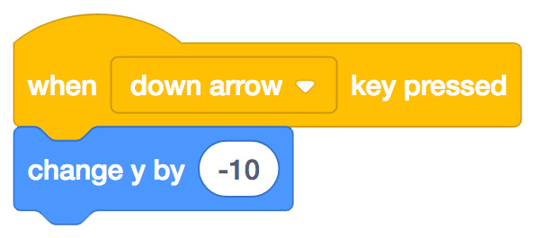




Make It Interactive
scratch.mit.edu
GET READY
Click to select your flying sprite.
ADD THIS CODE
Change x
Change y
Move your character side to side.
Move your character up and down.
Type a minus sign to move left.
Type a minus sign to move down.
TRY IT
Press the arrow keys on your keyboard to move your character around.

Slide 11
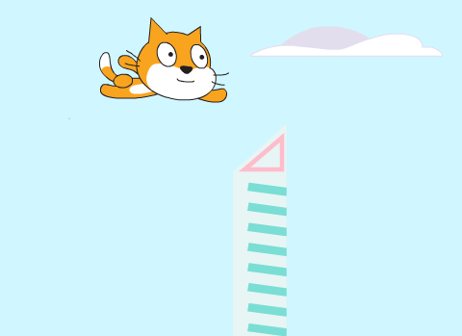
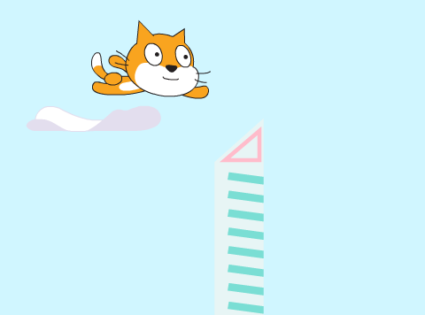
Floating Clouds
Make clouds float by in the sky!
yyyymmdd
Make It Fly
5

Slide 12

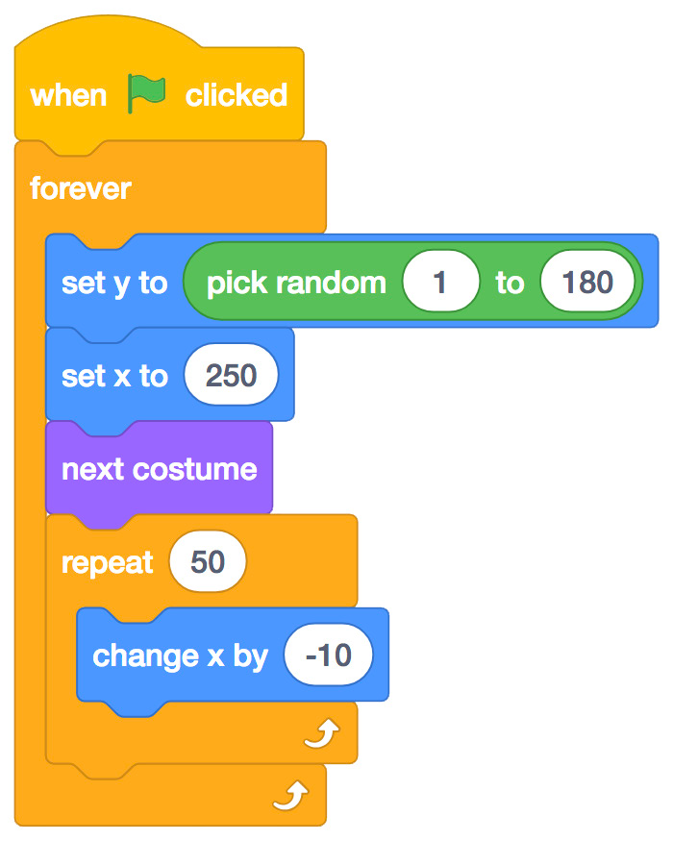
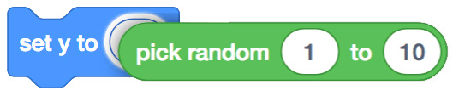
Floating Clouds
scratch.mit.edu
GET READY
Choose Clouds from the library.
ADD THIS CODE
Type 180 to keep Clouds in top half.
Drag the pick random block into the set y to block.
TIP
y is the position on the Stage from top to bottom.
y = 180
x = -240
x = 240
y = -180

Slide 13

Flying Hearts
Add hearts or other floating objects to
yyyymmdd
Make It Fly
6

Slide 14

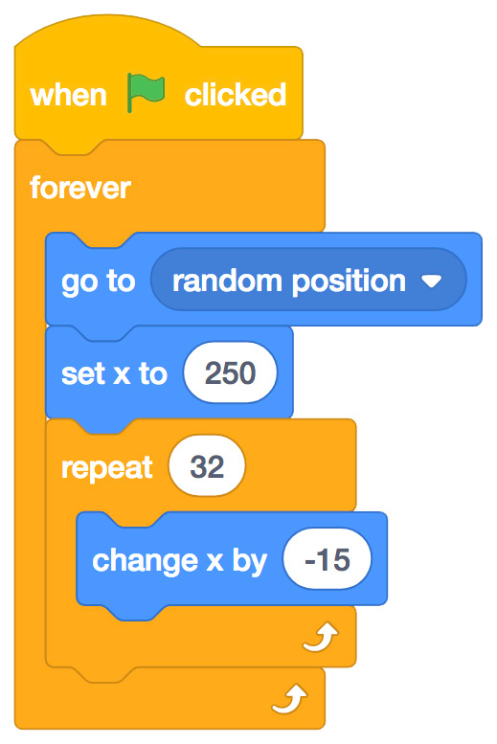
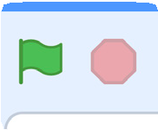
Flying Hearts
scratch.mit.edu
GET READY
Choose a sprite, such as Heart.
ADD THIS CODE
Moves the sprite up and down
Sets your sprite’s position at the far right of the stage
Moves the sprite across the stage
TRY IT
Click the green flag to start

Slide 15
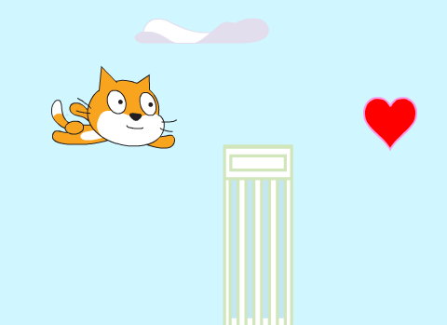

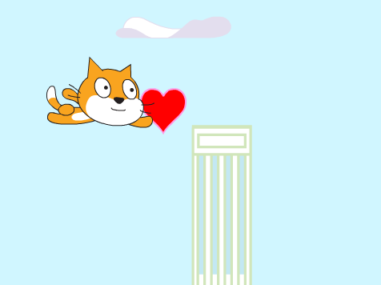

Collect Points
Add a point each time you touch a heart or other object.
yyyymmdd
Make It Fly
7

Slide 16
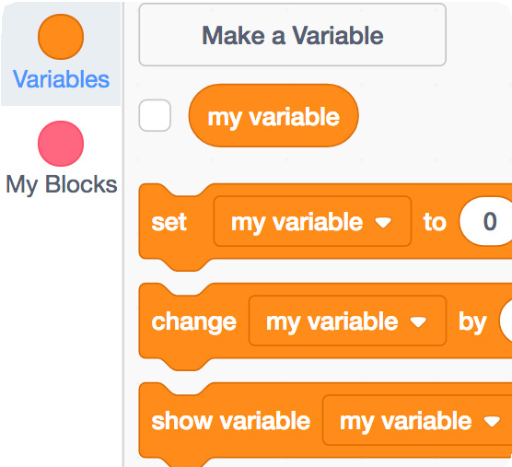
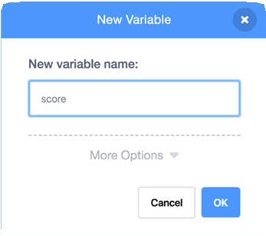
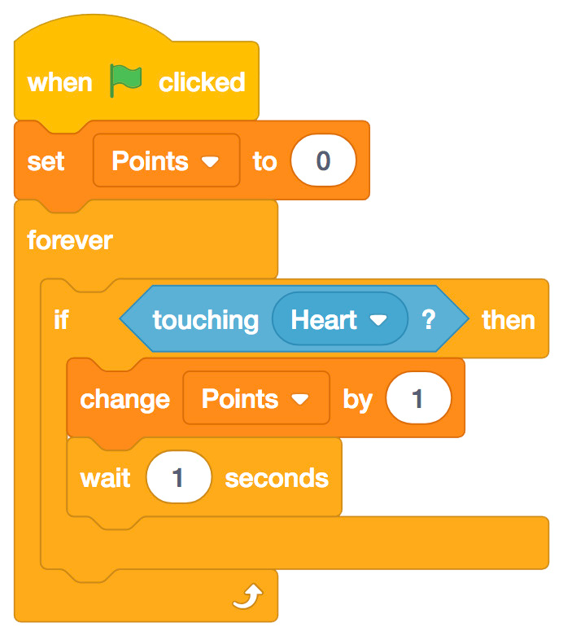
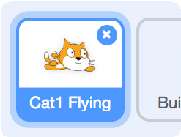
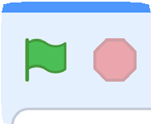
Collect Points
scratch.mit.edu
GET READY
Select Variable
Click the Make a Variable button.
Points
Name this variable Points and then click OK.
ADD THIS CODE
Resets points at the start.
Select your flying sprite.
Choose Heart from the menu.
Add a point.
TRY IT
Click the green flag to start

